Slide 1
Lecture
Financial Analysis
5
L.O. 13-1: Sustainable income and quality of earnings
L.O. 13-2: Horizontal analysis and vertical analysis
L.O. 13-3: Ratio analysis

Slide 2
Learning Objective 13-1
Sustainable Income and
Quality of Earnings

Slide 3
Outline
Sustainable Income
Discontinued operations
Comprehensive income
Quality of Earnings
Alternative accounting methods
Pro forma income
Improper recognition

Slide 4
Sustainable Income
Sustainable income is the most likely level of income to be obtained by a company in the future.
It differs from actual income by the amount of unusual revenues, expenses, gains, and losses included in the current year’s income.
It helps derive an estimate of future earnings without the “noise” of unusual items.
There are two major types of unusual items:
Discontinued operations
Other comprehensive income

Slide 5
Discontinued Operations
Disposal of a significant component of a business.
Report the income (loss) from discontinued operations in two parts:
Income (loss) from operations (net of tax)
Gain (loss) on disposal (net of tax).

Slide 6
Discontinued Operations
Illustration: During 2017 AE Inc. has income before income taxes of $80,000,000. During 2017, AE Inc. discontinued and sold its unprofitable chemical division. The loss in 2017 from chemical operations (net of $135,000 taxes) was $315,000. The loss on disposal of the chemical division (net of $81,000 taxes) was $189,000. Assuming a 30% tax rate on income.

Slide 7
Discontinued Operations
Discontinued Operations are reported after “Income from continuing operations.”
Previously labeled as “Net Income”.
Moved to

Slide 8
Comprehensive Income
Comprehensive income is the sum of
net income and
other comprehensive income items.
Example: Unrealized gains or losses on available-for-sale debt securities.

Slide 9
Comprehensive Income
Illustration: During 2017 Stassi Company purchased IBM stock for $10,500 as an investment. At the end of 2017, Stassi was still holding the investment, but the stock’s market price was now $8,000. In this case, Stassi is required to reduce the recorded value of its IBM investment by $2,000 (net of $500 tax savings). The $2,000 difference is an unrealized loss.
Should Stassi include this $2,000 unrealized loss in net income?
It depends on whether Stassi classifies the IBM stock as a trading security or an available-for-sale security.
Trading securities: Unrealized gains and losses are reported in the “Other expenses and losses” section of the income statement.
Available-for-sale securities: Unrealized gains and losses are reported as “Other comprehensive income”.

Slide 10
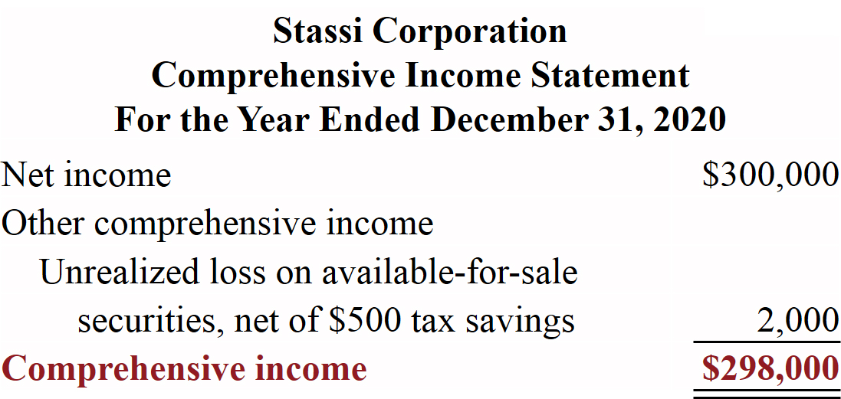
Comprehensive Income
Presentation in Comprehensive Income Statement

Slide 11
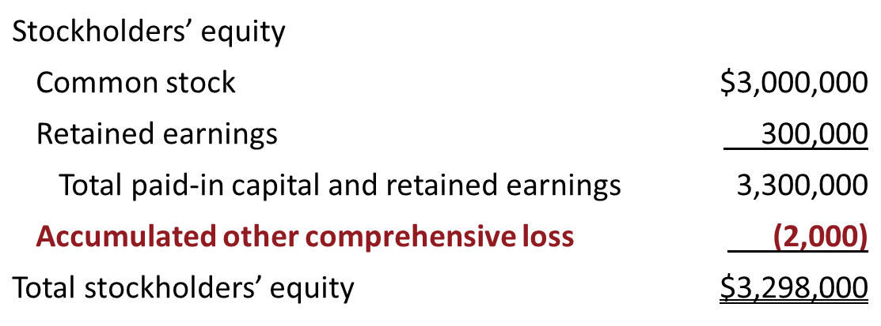
Comprehensive Income
Presentation in Balance Sheet
Assume Stassi has common stock of $3,000,000, retained earnings of $300,000, and accumulated other comprehensive loss of $2,000. This illustration shows the balance sheet presentation of the accumulated other comprehensive loss.
Balance Sheet (partial)

Slide 12
Comprehensive Income
Reporting the unrealized gain or loss in the stockholders’ equity section of the balance sheet and below net income in the statement of comprehensive income has two important purposes:
It reduces the volatility of net income due to fluctuations in fair value
Inform users of the gain/loss that would occur if the company sold the securities at fair value

Slide 13
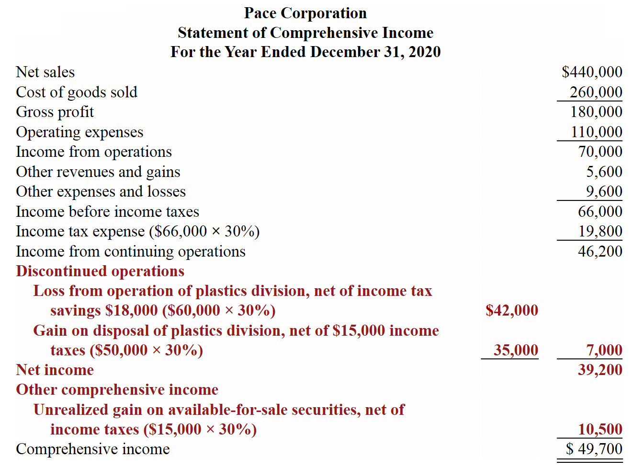
Comprehensive Income
Complete Statement of Comprehensive Income

Slide 14
Changes in Accounting Principle
Occurs when the principle used in the current year is different from the one used in the preceding year.
Example: Change in inventory costing methods (such as F I F O to average-cost)
Accounting rules permit a change when management can show that the new principle is preferable.
Companies report most changes in accounting principle retroactively.

Slide 15
Quality of Earnings
A high quality of earnings provides full and transparent information that will not confuse or mislead users.
Alternative Accounting Methods
Variations among companies in the application of generally accepted accounting principles may hamper comparability and reduce quality of earnings
F I F O versus L I F O inventory cost flow
Straight-line versus declining balance depreciation

Slide 16
Quality of Earnings
Pro Forma Income
Companies whose stock is publicly traded are required to present their income statement following GAAP.
Many companies have been also reporting pro forma income that usually excludes items that the company thinks are unusual or non-recurring (pro forma income).
Many analysts and investors are critical of using pro forma income because these numbers often make companies look better than they really are.

Slide 17
Quality of Earnings
Improper Recognition
Most common abuse is improper recognition of revenue.
Channel stuffing (Bristol-Myers Squibb)
Another practice is improper capitalization of operating expenses.
Capitalization of operating expenses (WorldCom)
Failure to report liabilities (Enron)

Slide 18
Learning Objective 13-2
Horizontal Analysis and
Vertical Analysis

Slide 19
Outline
Horizontal analysis
Vertical analysis

Slide 20
Analyzing Financial Statements
Analyzing financial statements involves:
Characteristics
Comparison
Bases
Tools of
Analysis
Liquidity
Profitability
Solvency
Intracompany
Industry averages
Intercompany
Horizontal
Vertical
Ratio

Slide 21
Horizontal Analysis
Horizontal analysis, also called trend analysis, is a technique for evaluating a series of financial statement data over a period of time.
Purpose is to determine the increase or decrease.
Commonly applied to the
Balance sheet.
Income statement.
Statement of retained earnings.

Slide 22
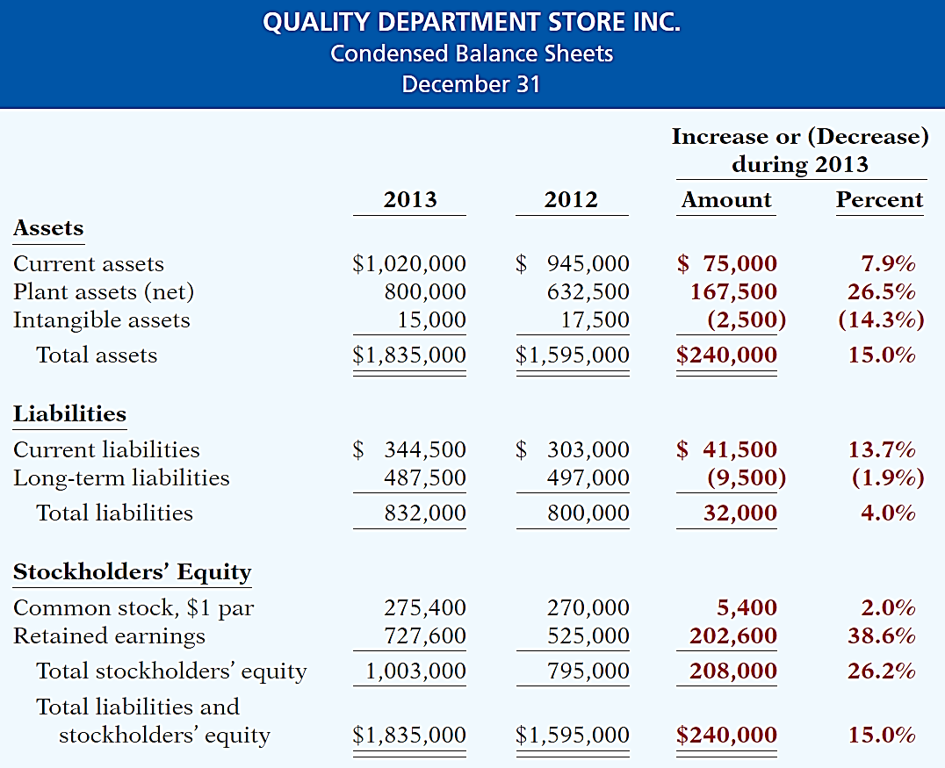
Horizontal Analysis
Changes suggest that the company expanded its asset base during 2013 and financed this expansion primarily by retaining income rather than assuming additional long-term debt.

Slide 23
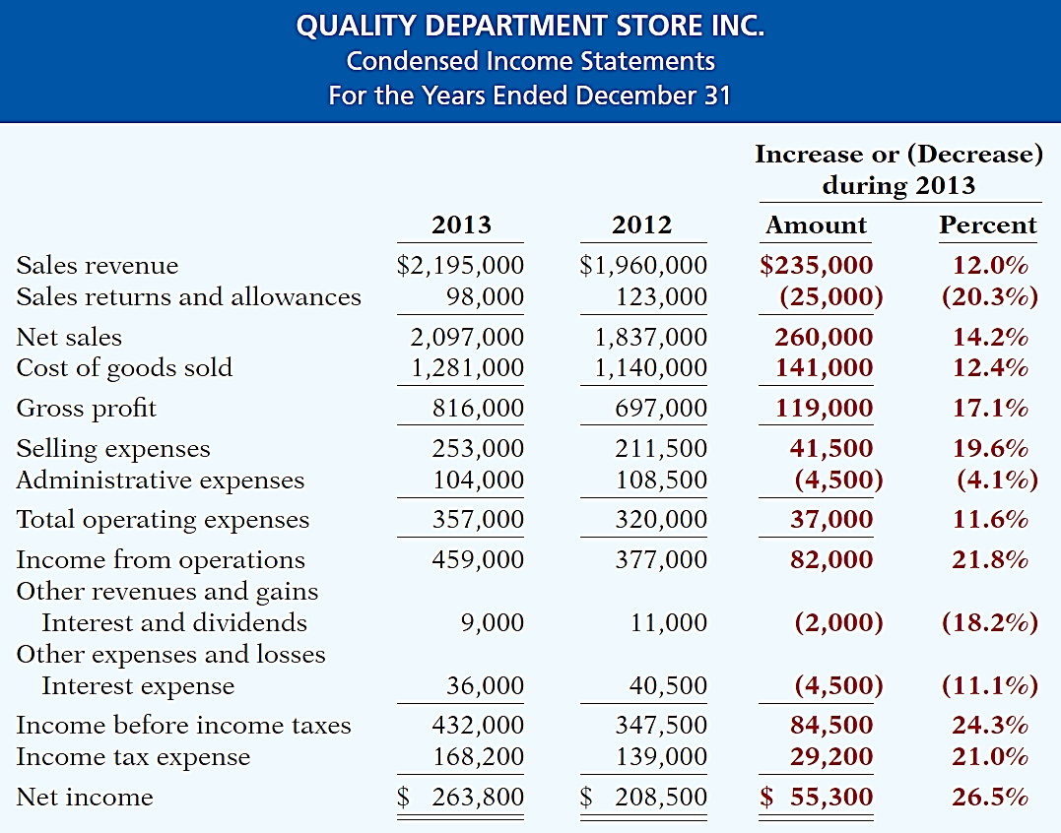
Horizontal Analysis
Overall, gross profit and net income were up substantially. Gross profit increased
17.1%, and net income, 26.5%. Quality’s profit trend appears favorable.

Slide 24
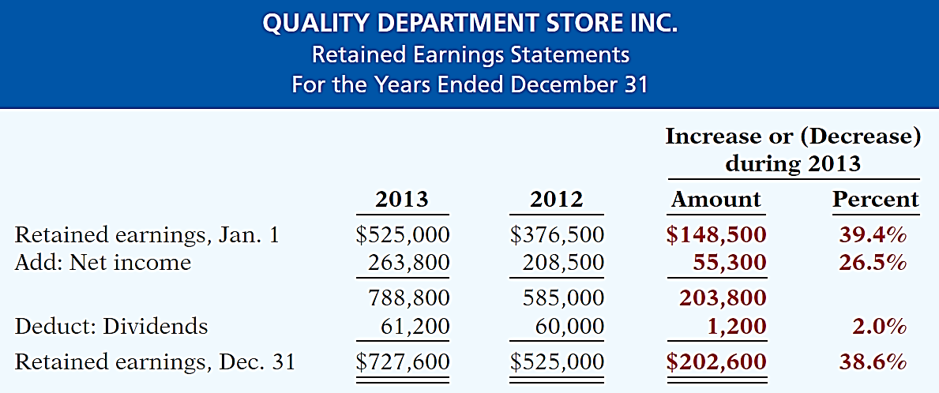
Horizontal Analysis
The ending retained earnings increased 38.6%. As indicated earlier, the company retained a significant portion of net income to finance additional plant facilities.

Slide 25
Vertical Analysis
Vertical analysis, also called common-size analysis, is a technique that expresses each financial statement item as a percent of a base amount.
On an income statement, we might say that selling expenses are 16% of net sales.
Vertical analysis is commonly applied to the
Balance sheet
Income statement.

Slide 26
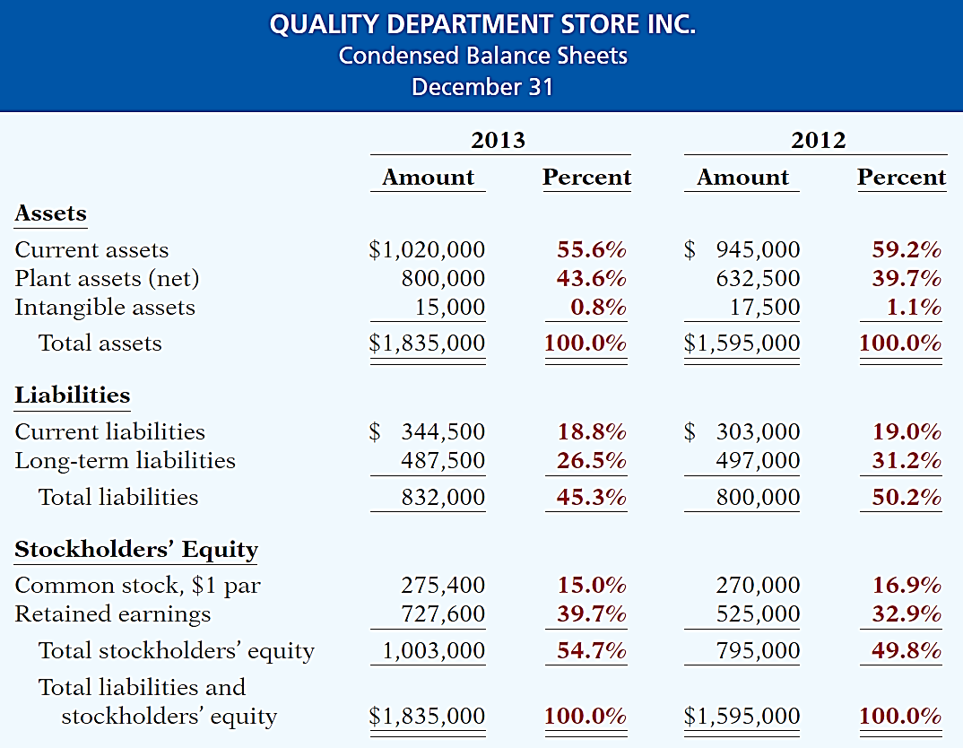
Vertical Analysis
Quality is choosing to finance its growth through retention of earnings rather than through issuing additional debt.
Base

Slide 27
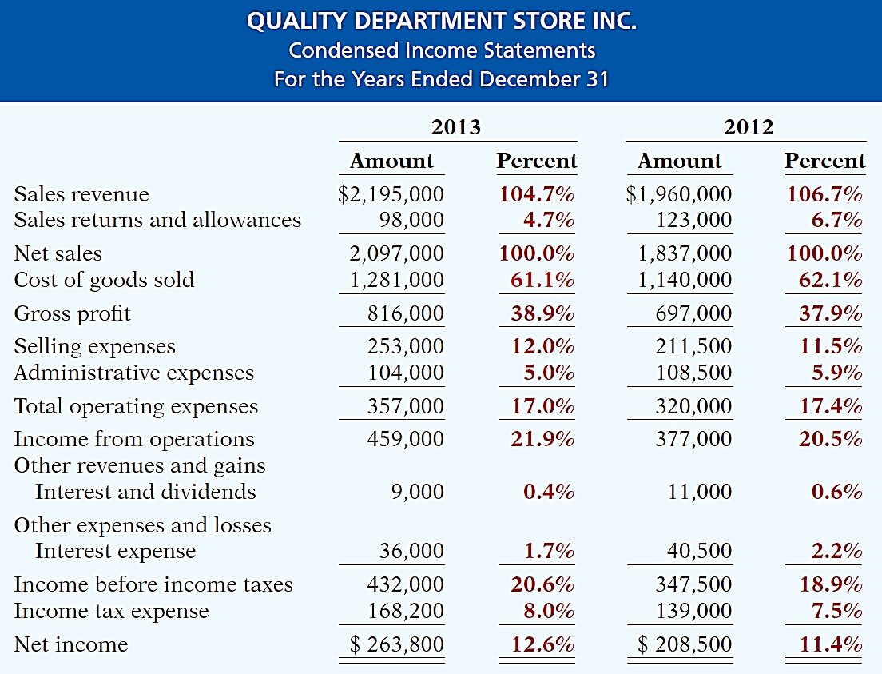
Vertical Analysis
Quality appears
to be a profitable enterprise that is becoming even more successful.
Base

Slide 28
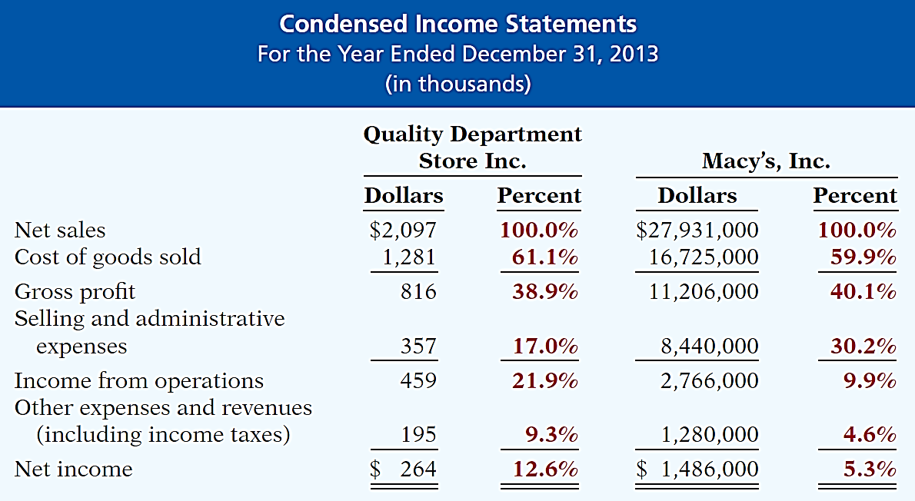
Vertical Analysis
Enables a comparison of companies of different sizes.

Slide 29
Learning Objective 13-3
Ratio Analysis

Slide 30
Outline
Liquidity ratios
Solvency ratios
Profitability ratios

Slide 31
Ratio Analysis
Ratio analysis expresses the relationship among selected items of financial statement data.
Financial Ratio Classifications
Liquidity
Solvency
Profitability
Measures short-term ability of the company to pay its maturing obligations and to meet unexpected needs for cash.
Measures the ability of the company to survive over a long period of time.
Measures the income or operating success of a company for a given period of time.

Slide 32
Liquidity Ratios
Measure the short-term ability of the company to pay its maturing obligations and to meet unexpected needs for cash.
Short-term creditors such as bankers and suppliers are particularly interested in assessing liquidity.
Ratios include the working capital, the current ratio, inventory turnover, days in inventory, accounts receivable turnover and average collection period.

Slide 33
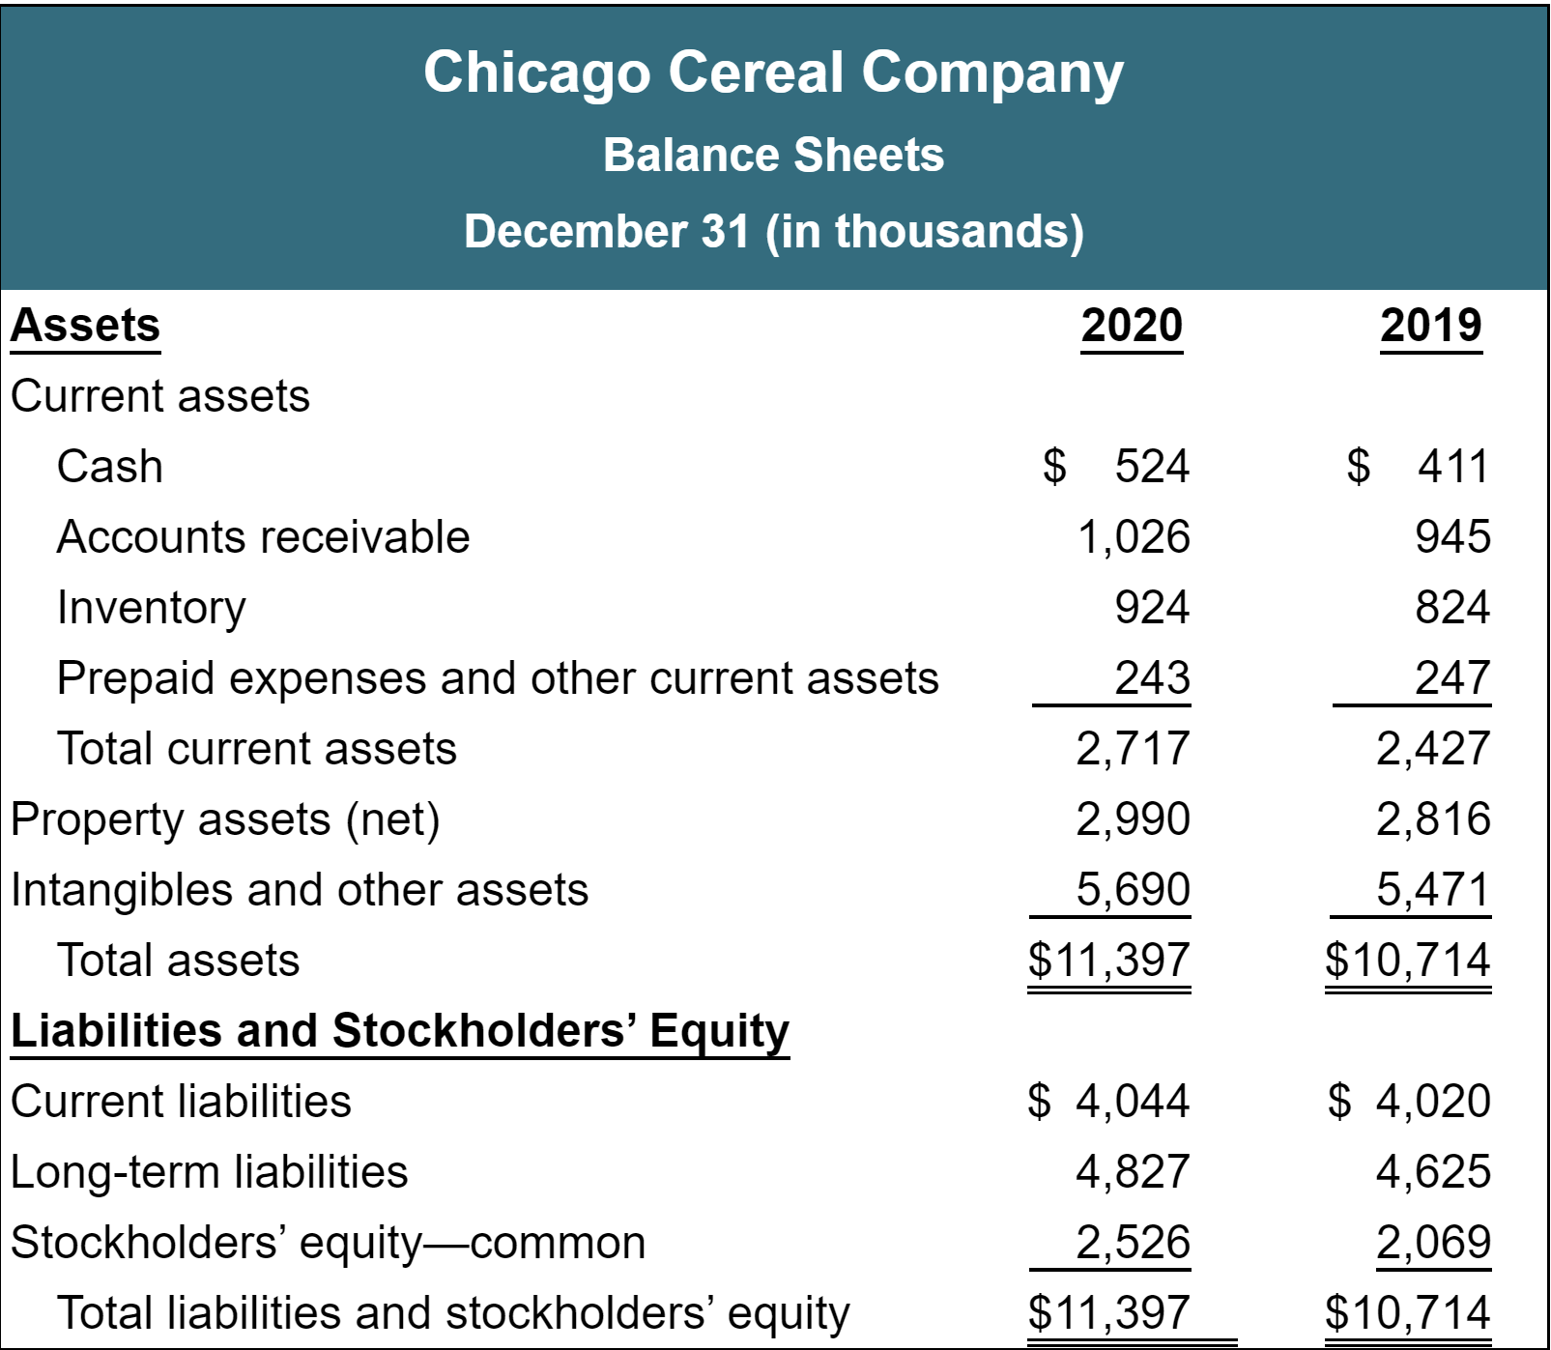
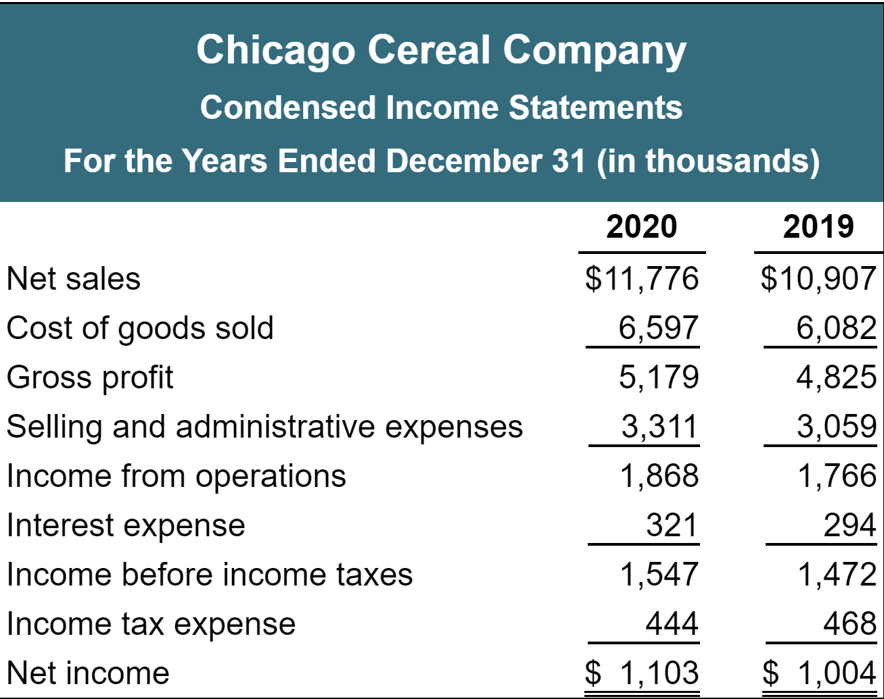
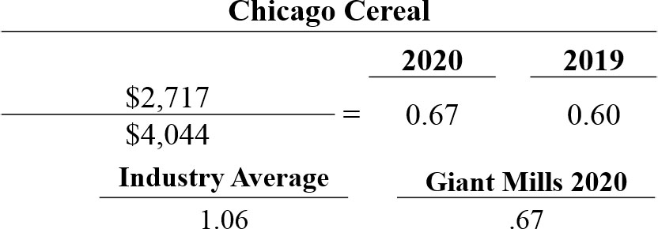
Liquidity Ratios
Chicago has $0.67 of current assets for every dollar of current liabilities.

Slide 34
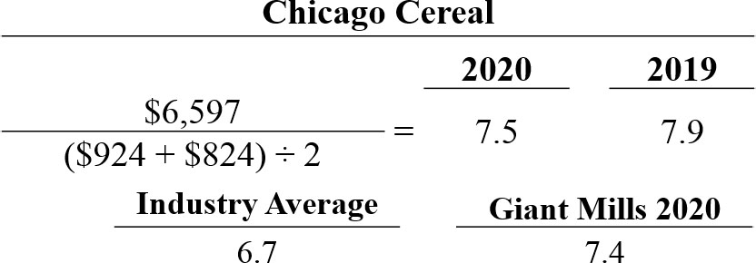
Liquidity Ratios
The faster the inventory turnover, the less cash is tied up in inventory and less chance of inventory becoming obsolete.

Slide 35
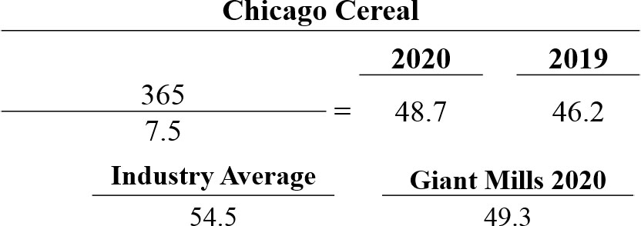
Liquidity Ratios
Measures the average number of days inventory is held.

Slide 36
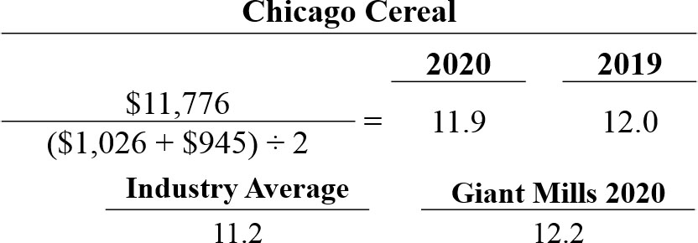
Liquidity Ratios
Assume all sales are credit sales
Measures the number of times, on average, the company collects receivables during the period.

Slide 37
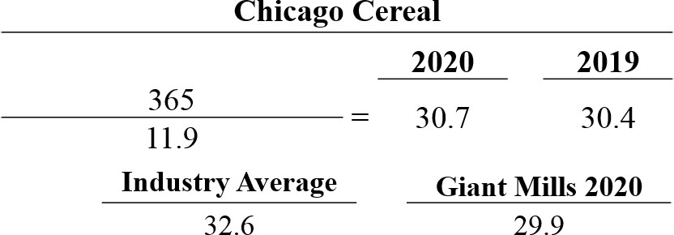
Liquidity Ratios
Analysts frequently use average collection period to assess the effectiveness of a company’s credit and collection policies.

Slide 38
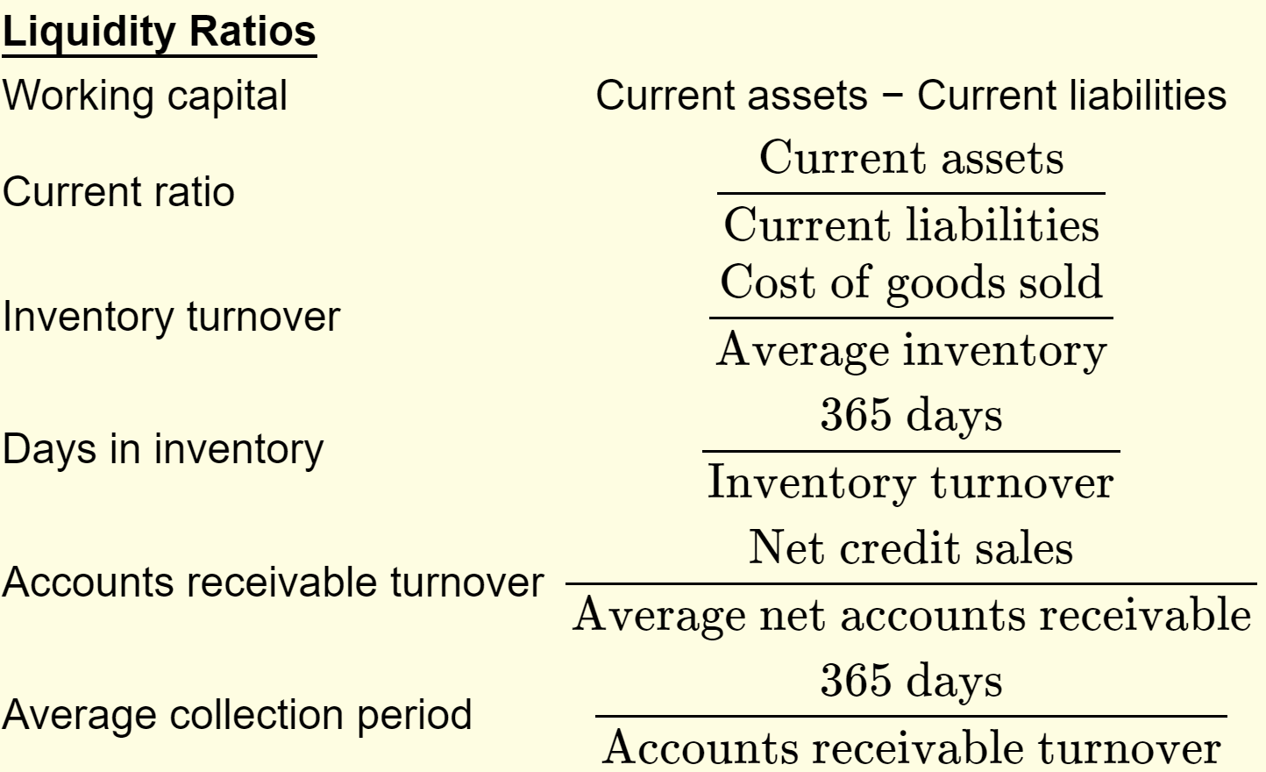
Summary of Liquidity Ratios

Slide 39
Ratio Analysis
Ratio analysis expresses the relationship among selected items of financial statement data.
Financial Ratio Classifications
Liquidity
Solvency
Profitability
Measures short-term ability of the company to pay its maturing obligations and to meet unexpected needs for cash.
Measures the ability of the company to survive over a long period of time.
Measures the income or operating success of a company for a given period of time.

Slide 40
Solvency Ratios
Measure the ability of a company to survive over a long period of time.
Debt to assets ratio and times interest earned provide information about debt-paying ability
Free cash flow provides information about solvency and ability to pay additional dividends or invest in new projects

Slide 41
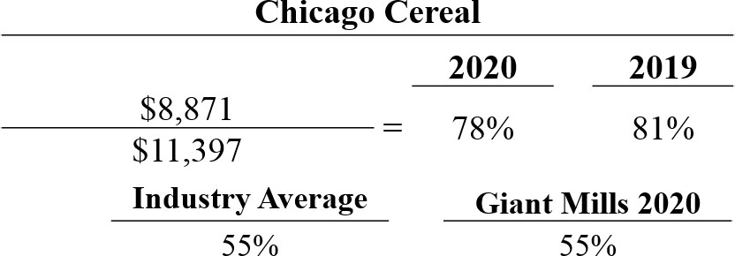
Solvency Ratios
Provides some indication of company’s ability to withstand losses without impairing the interests of its creditor.

Slide 42
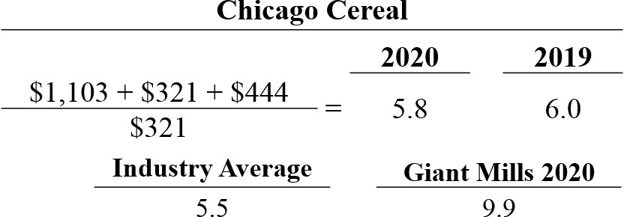
Solvency Ratios
Provides an indication of company’s ability to meet interest payments as they come due.

Slide 43
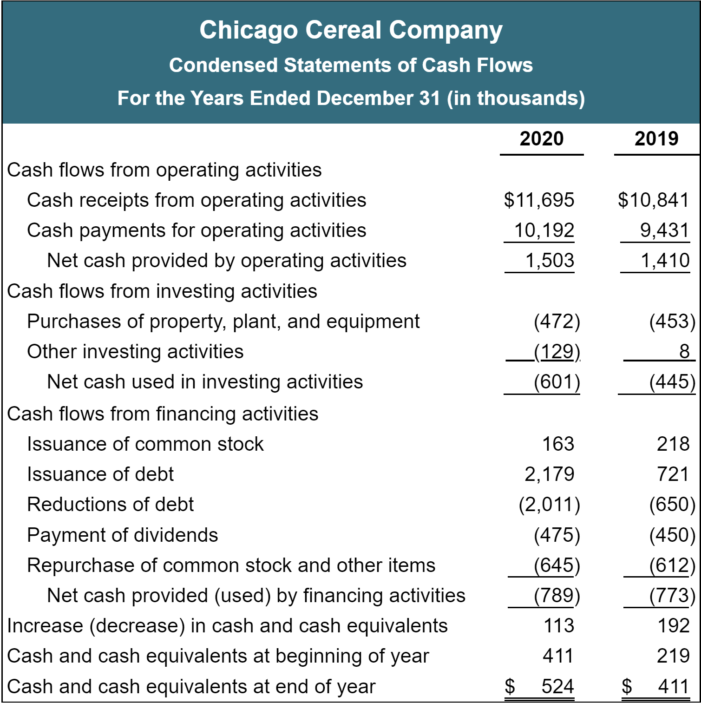
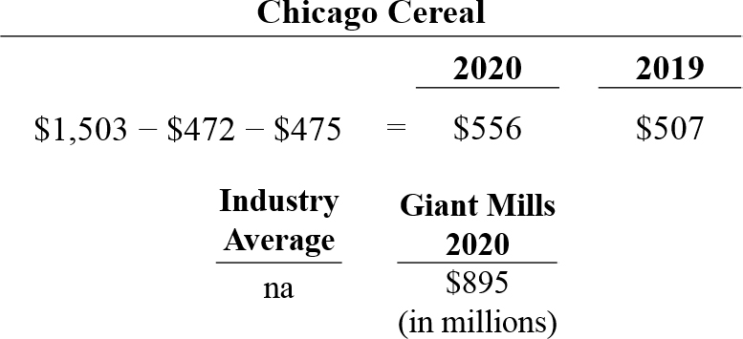
Solvency Ratios
One indication of solvency is the amount of excess cash generated after investing in capital expenditures and paying dividends.

Slide 44
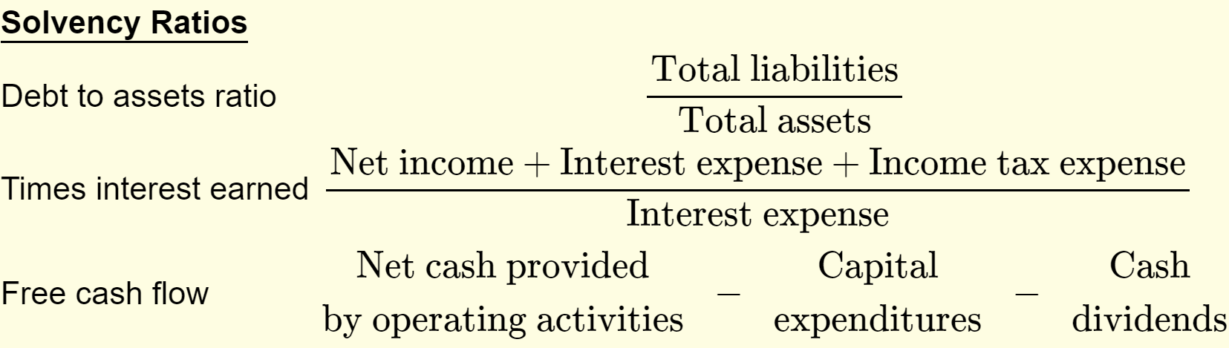
Summary of Solvency Ratios

Slide 45
Ratio Analysis
Ratio analysis expresses the relationship among selected items of financial statement data.
Financial Ratio Classifications
Liquidity
Solvency
Profitability
Measures short-term ability of the company to pay its maturing obligations and to meet unexpected needs for cash.
Measures the ability of the company to survive over a long period of time.
Measures the income or operating success of a company for a given period of time.

Slide 46
Profitability Ratios
Measure the income or operating success of a company for a given period of time.
Income affects the company’s ability to obtain debt and equity financing, their liquidity position, and their ability to grow.
Ratios include the earnings per share, price-earnings ratio, gross profit rate, profit margin, return on assets, asset turnover, payout ratio, and return on common stockholders’ equity.

Slide 47
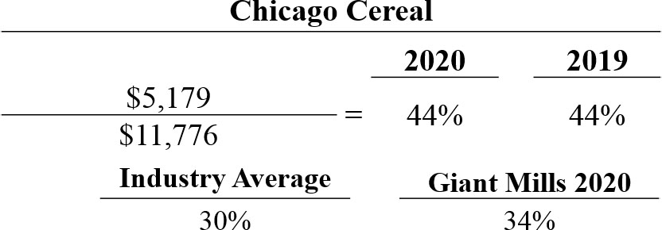
Profitability Ratios
Indicates a company’s ability to maintain an adequate selling price above its cost of goods sold.

Slide 48
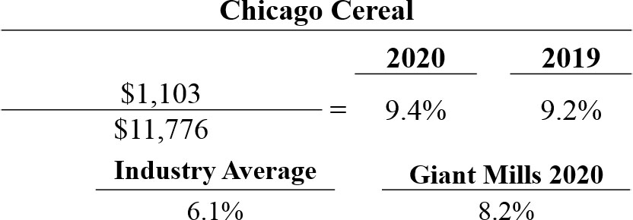
Profitability Ratios
Measures of the percentage of each dollar of sales that results in net income.

Slide 49
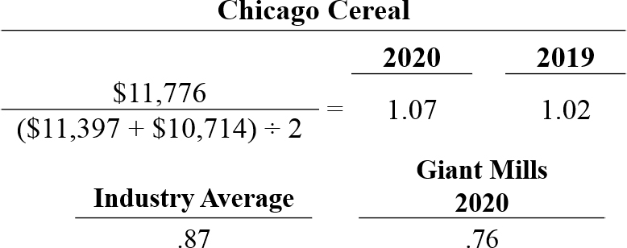
Profitability Ratios
Measures how efficiently a company uses its assets to generate sales.

Slide 50
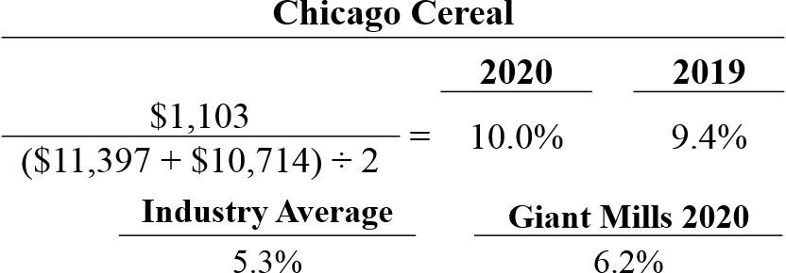
Profitability Ratios
Measures the overall profitability of assets in terms of the income earned on each dollar invested in assets.

Slide 51
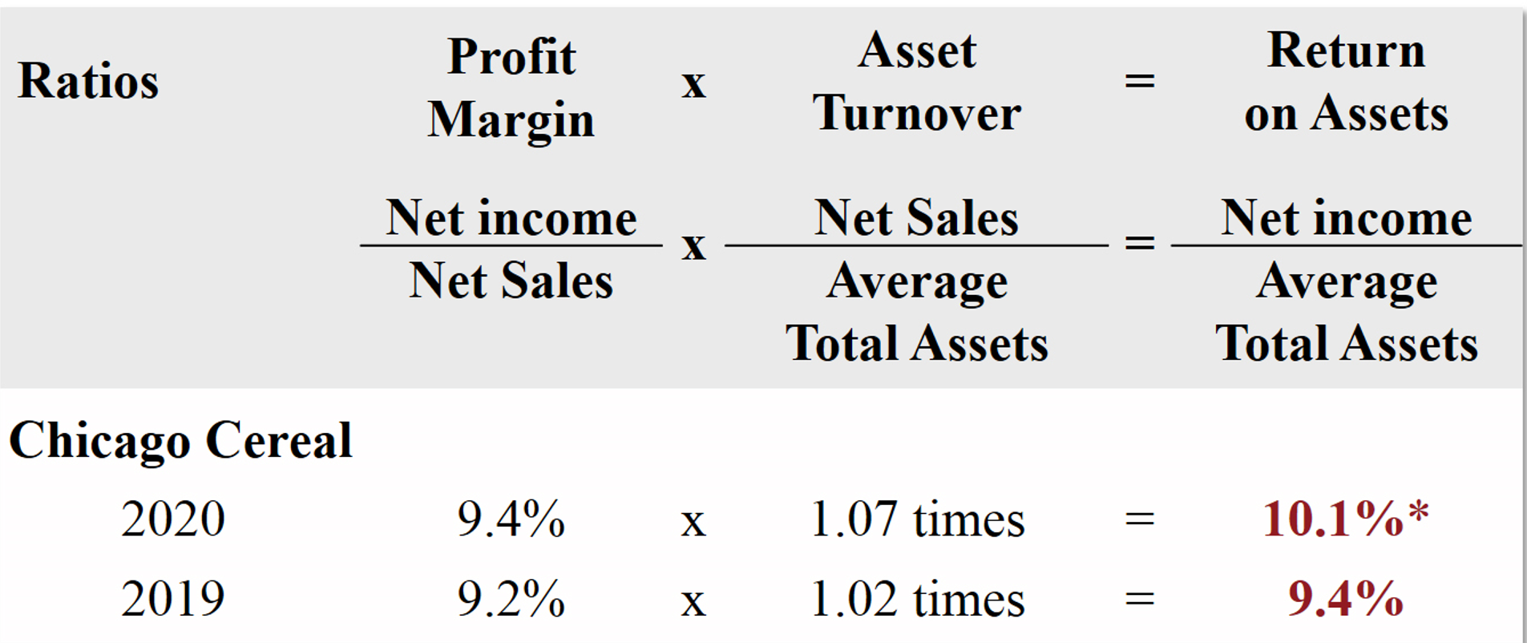
Profitability Ratios
Composition of Return on Assets

Slide 52
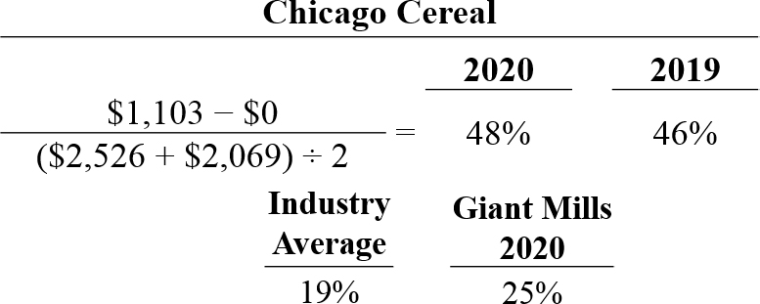
Profitability Ratios
Shows how many dollars of net income the company earned for each dollar invested by the owners.

Slide 53
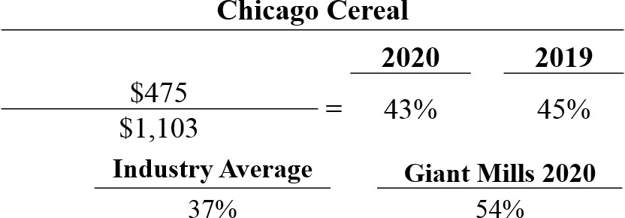
Profitability Ratios
Measures the percentage of earnings distributed in the form of cash dividends.

Slide 54
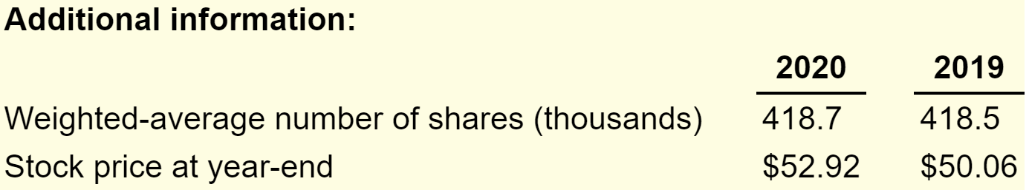
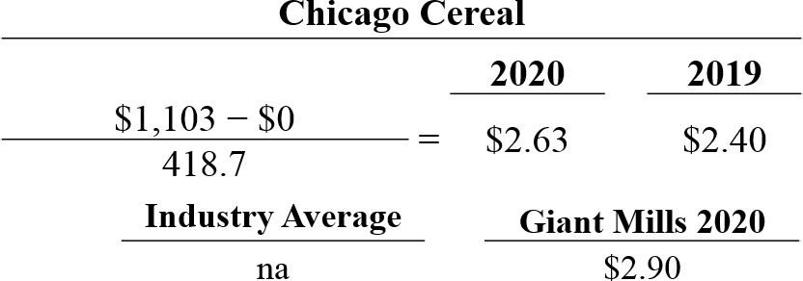
Profitability Ratios
A measure of the net income earned on each share of common stock.

Slide 55

Profitability Ratios
Reflects investors’ assessments of a company’s future earnings.

Slide 56
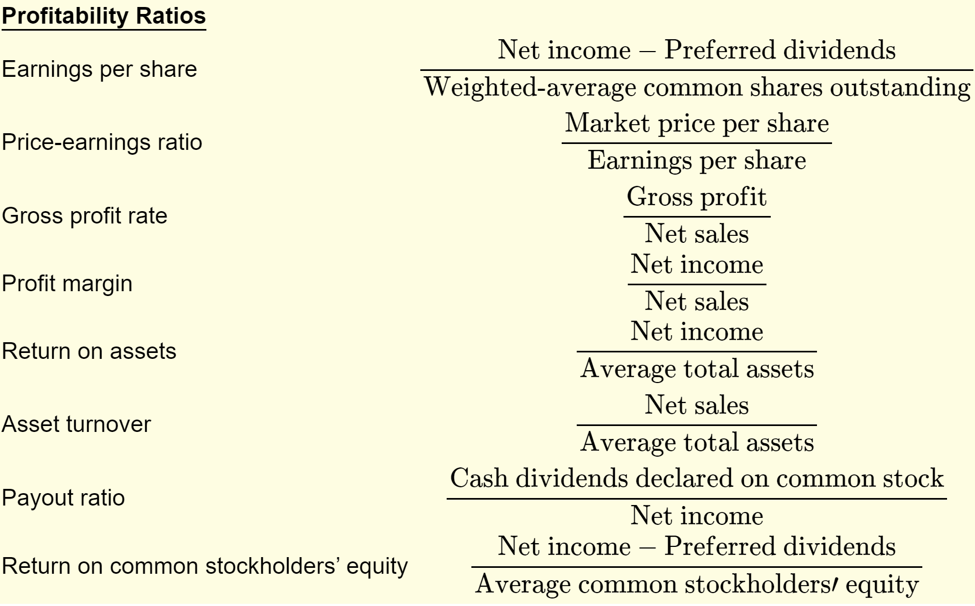

Summary of Profitability Ratios

